Slide 1


Revealing
Uncommon
Tricks
25 Obscure Pandas & NumPy Hacks learnt over 5 years of being a Data Scientist
Notes:
Hello everyone, Thank you for your interest in this topic. I'm sure most of you who are passionate in data science have heard of the 2 prominent open source python libraries - Pandas and numpy. Many of you might have used it in your day to day work life. The content of this talk, is not going to be something that includes everyday usage. We'll see an example of what those are in a minute.

Slide 2










Nitin Kishore Sai Samala
My presentation, comments and opinions are provided in my personal capacity and not as a representative of Walmart. They do not reflect the views of Walmart and are not endorsed by Walmart.
Notes:
This talk is about some obscure tricks that you'll only get to come across through a painstaking effort in fixing or debugging your code. This is a short compilation of some of those instances that i picked up in over 5 years of being a data scientist. Keeping in mind the duration, I won’t go into how i happened to figure these out, but rather what the solution to the problems were. I'm hoping you'll leave this talk with some new ideas and code snippets that you'd be excited to try as soon as you can.

Slide 3


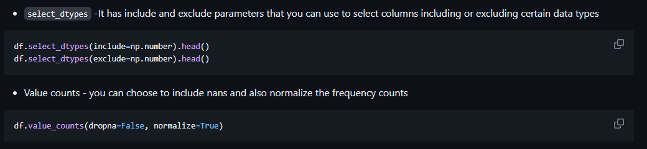

SOME BASIC EDA TIPS
To reduce memory usage, convert `object` to `category` datatype
Downcast int values based on your feature range as `int64` takes up a huge space. Switch to `int8` if it's within -127 to 128
`float32` will same value till 6 decimal places. Downcast from 64 bit
Convert binary feature value columns to Boolean
Be careful when dealing with zero inflated skew count data and use `log transform` after making it fully positive by adding the abs(min) of the data plus an offset like 0.01
PyCon India 2023
Notes:
Some of the basics every data scientist should know are the following. Simple tips. Nothing too fancy. However, sometimes you might want to analyze few features or get a sense of your data before you get down to cleaning it. If you want to isolate and look at specific data types or include number of nans to see how much cleaning is required or what percentage of a feature is missing, you can do the following.

Slide 4
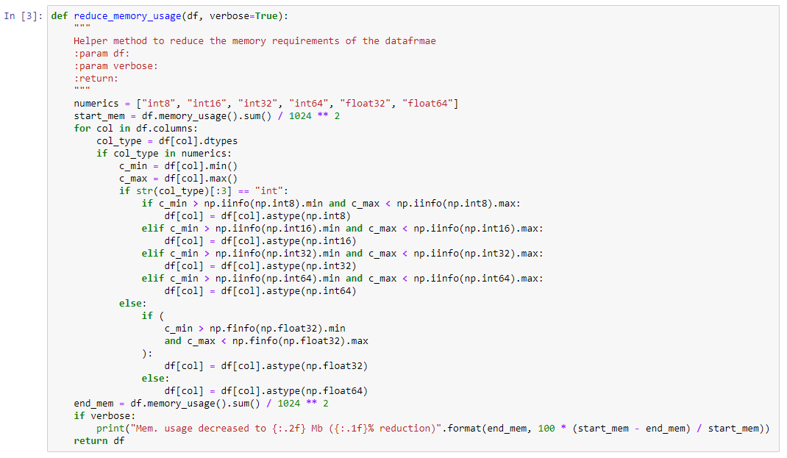
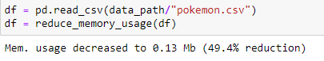
Reduced memory
Notes:
Based on the previous tips. Let’s talk about reducing the memory of all data types available in your data frame. If you can have a helper method like this you can call it whenever you read a dataframe and instantly reduce the memory drain. This is very important when dealing with large datasets. Sometimes you can have more than 50% reduction in size

Slide 5
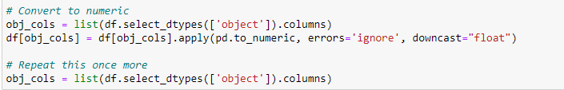
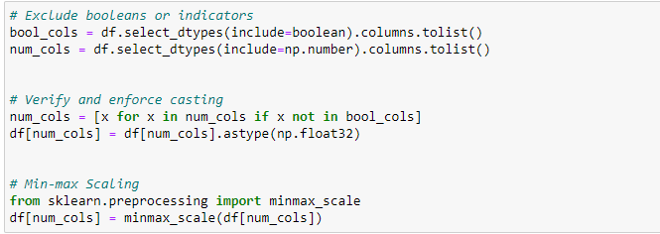
Data Types – Read them Right !
Notes:
But sometimes, your pandas dataframe might be reading a lot of numeric columns as strings or any other type of mismatch. A bit of manual intervention is a good check to have. Convert everything to numeric and cast whatever is possible. Then when you need to perform scaling only on the numeric columns you can isolate them easily if you maintain the column names in a list. Try to exclude Booleans or index columns from getting scaled.

Slide 6
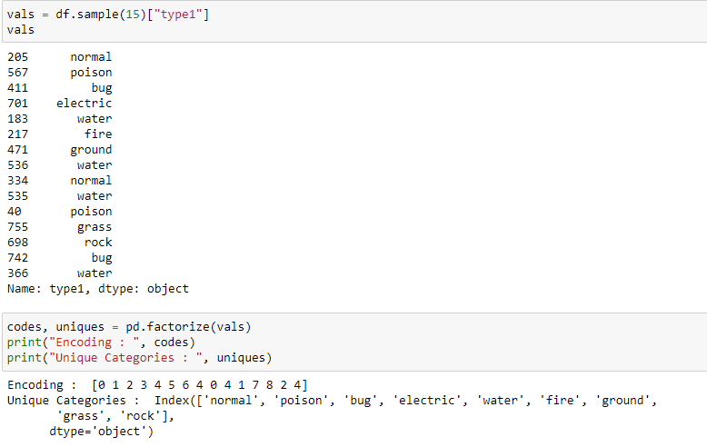
Let’s not get Categorical
It might be usual practice for you to either write a lengthy if-else conditional and use apply to convert
You might be tempted to use sklearn.preprocessing.LabelEncoder
There is a simpler and faster way to handle this with `pd.factorize()`
Notes:
Categorical data is sometimes tricky to handle because there is no one size fits all and your data could be a single token or a huge text string. If you are dealing with a class type feature and want to encode, you can try factorize instead of the usual

Slide 7
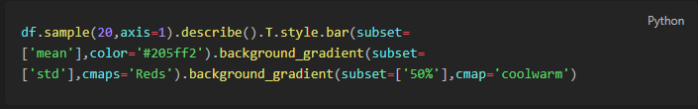
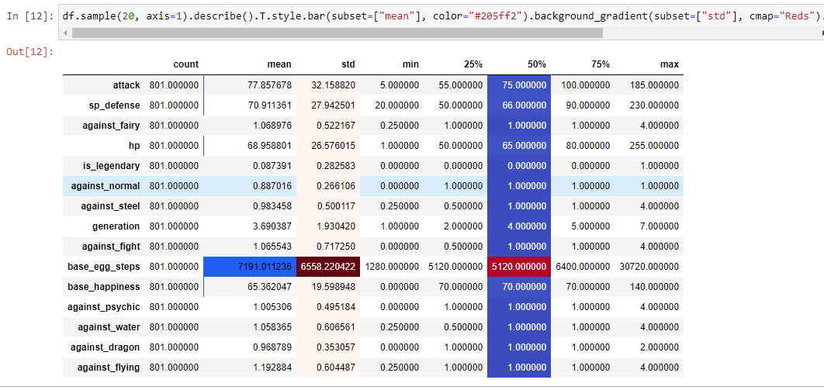
A colorful description
Notes:
Now when you perfom EDA, You can’t spot irregularities or concerns in your data by just looking at the numbers. Sometimes its helpful to add some color to your descriptions. You can display stylized dataframes. Raw df are rendered as html tables with a bit of CSS inside jupyter

Slide 8
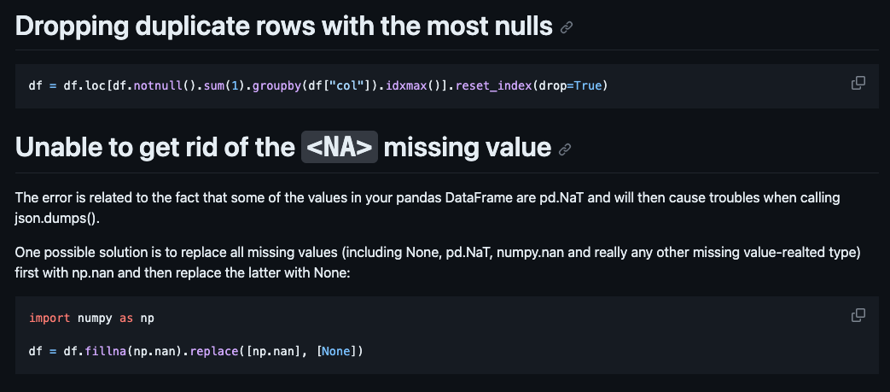
Dealing with those pesky Nans
Notes:
Cleaning up missing data or nulls is the bane of every data scientist. The number of times something slips through only to be found in the training loss, should make this a priority concern. I recently ran into an error where fillna didn’t help. That’s because some SQL tables have a type called NA which doesn’t register properly. It’s always good to first fill your nans with a nan from numpy and then fill it with your strategy or 0, mean, mode or median. One thing that skips people’s mind when dealing with large data is to check for duplicates. Often times removing duplicates can get rid of nans too. Only if you’re smart about it. You can’t simply delete the first or last occurrence. Delete the occurrence with the most nans instead.

Slide 9
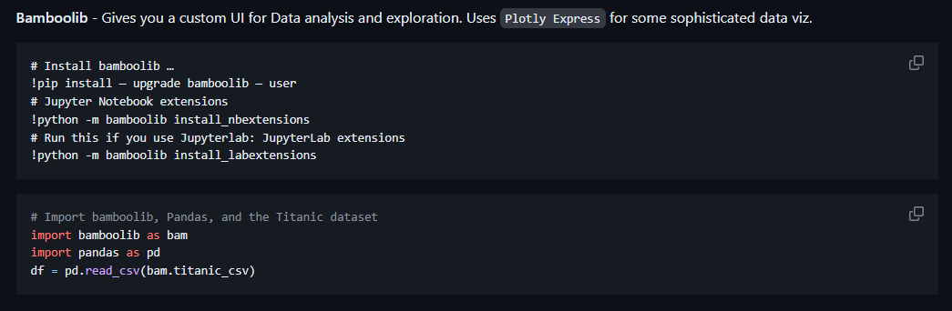
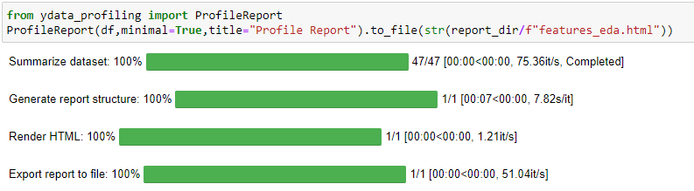
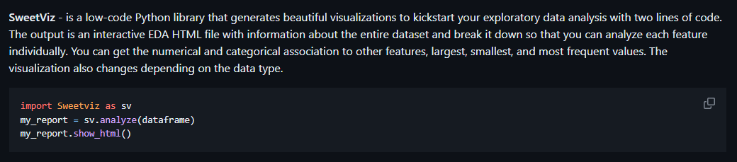
Automate EDA
Notes:
And finally, we have an important aspect of data cleaning in pandas. Exploratory data analysis. visualizing an individual features. Running them through an automated EDA library to speed up your work will quite frankly improve your life. Bamboo and sweetviz are some alternatives but the best tool I found is ydata_profiling, or what was previously called pandas profiling , . Here’s a video of what the generated report looks like on the pokemon dataset

Slide 10
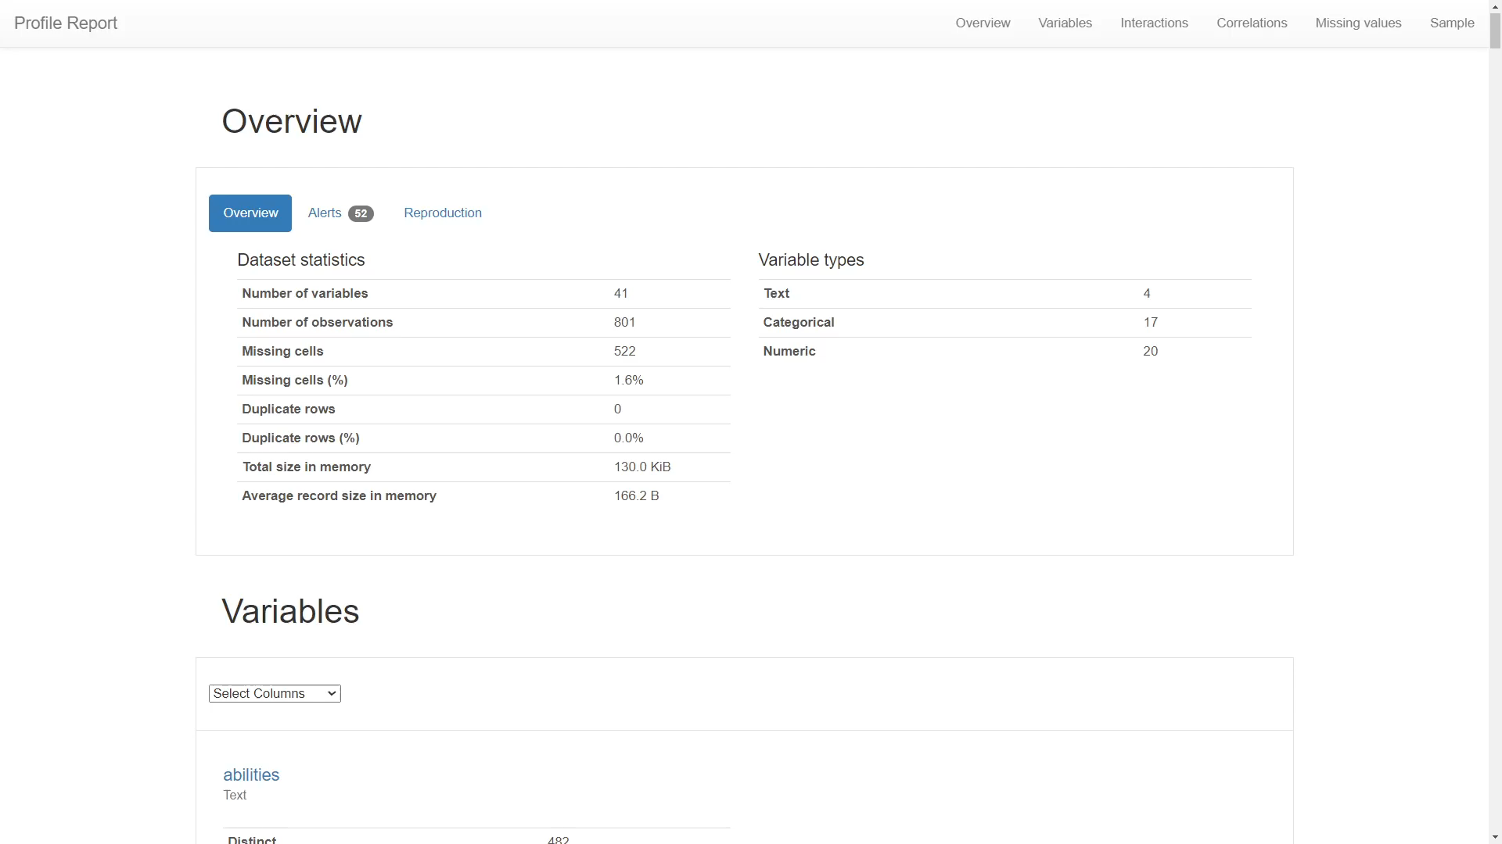
Notes:
A quickly generated html report from the dataframe , where you observe a complete overview of the manual steps you’d normally run. histograms of value counts, stats from describe and wordclouds for categorical features . This condensed alerts tab shows which features missing , high cardinality of values, zero skew to decide feature importance. One cool aspect is that you get to see interactions and correlations of pairs of features visualized in a very interactive manner. Instead of generating multiple plots in your jupyter notebook. It makes it easier to isolate missing features and decide on how to handle them. You get a full holistic view of the data in one shot. I highly recommend switching to this approach so you spend less time on cleaning data and more time exploring models

Slide 11
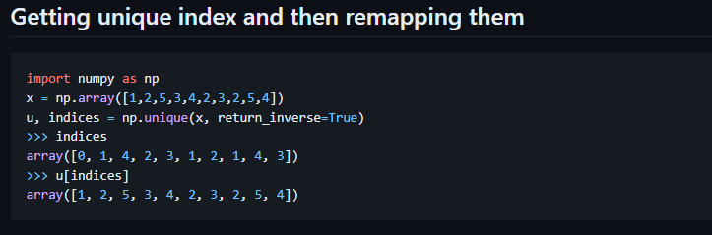
NUMPY analog for Factorize
PyCon India 2023
Notes:
Similar to how we used factorize for categorical data type, sometimes you might find yourself needing to reindex a subset of your data , especially when working with graphs and edge indices. So Numpy has a .unique method that does the same function as pandas factorize but for numbers

Slide 12


FEATURE ENGINEERING
Space
Latitude and Longitude
Time
Expand on a timestamp
Distance
Calculate between coordinates
Duration
Different timescales and lags
PyCon India 2023
Notes:
Let’s come to some feature engineering steps in pandas, specifically dealing with spatial and temporal data

Slide 13
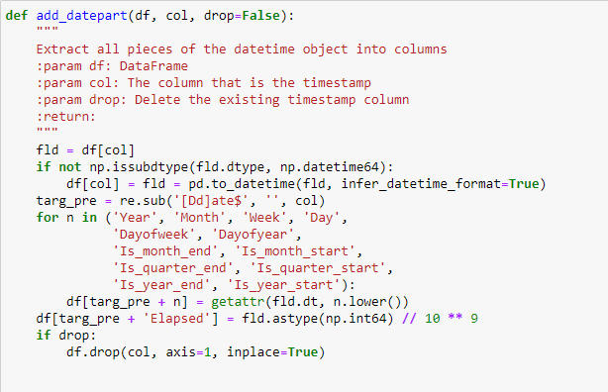
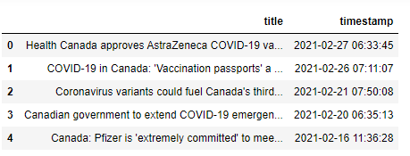
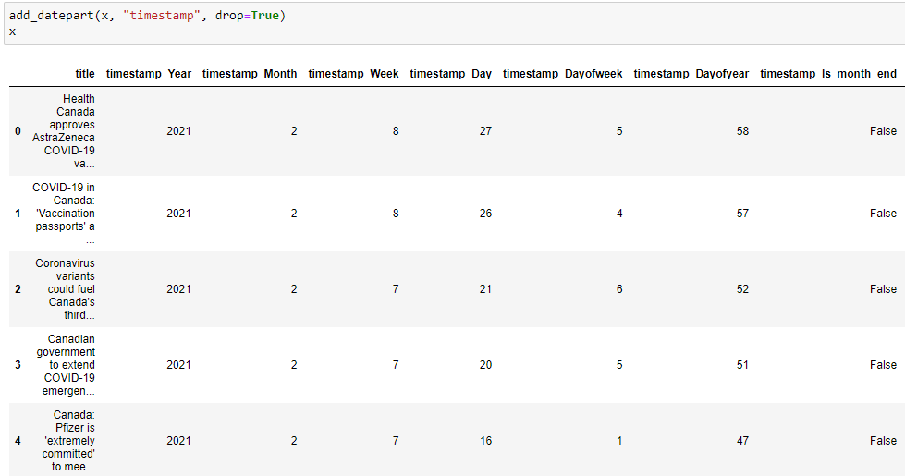
Notes:
Expand on your timestamp. An ML model won’t understand how to compare or unpack a timestamp unless we create some derivative features from it. This is a cool trick I learnt during a fast.ai course. You can split a timestamp into multiple int or Boolean features.

Slide 14
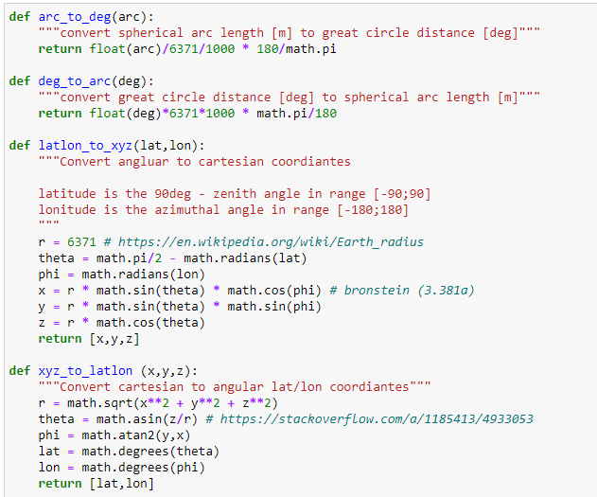
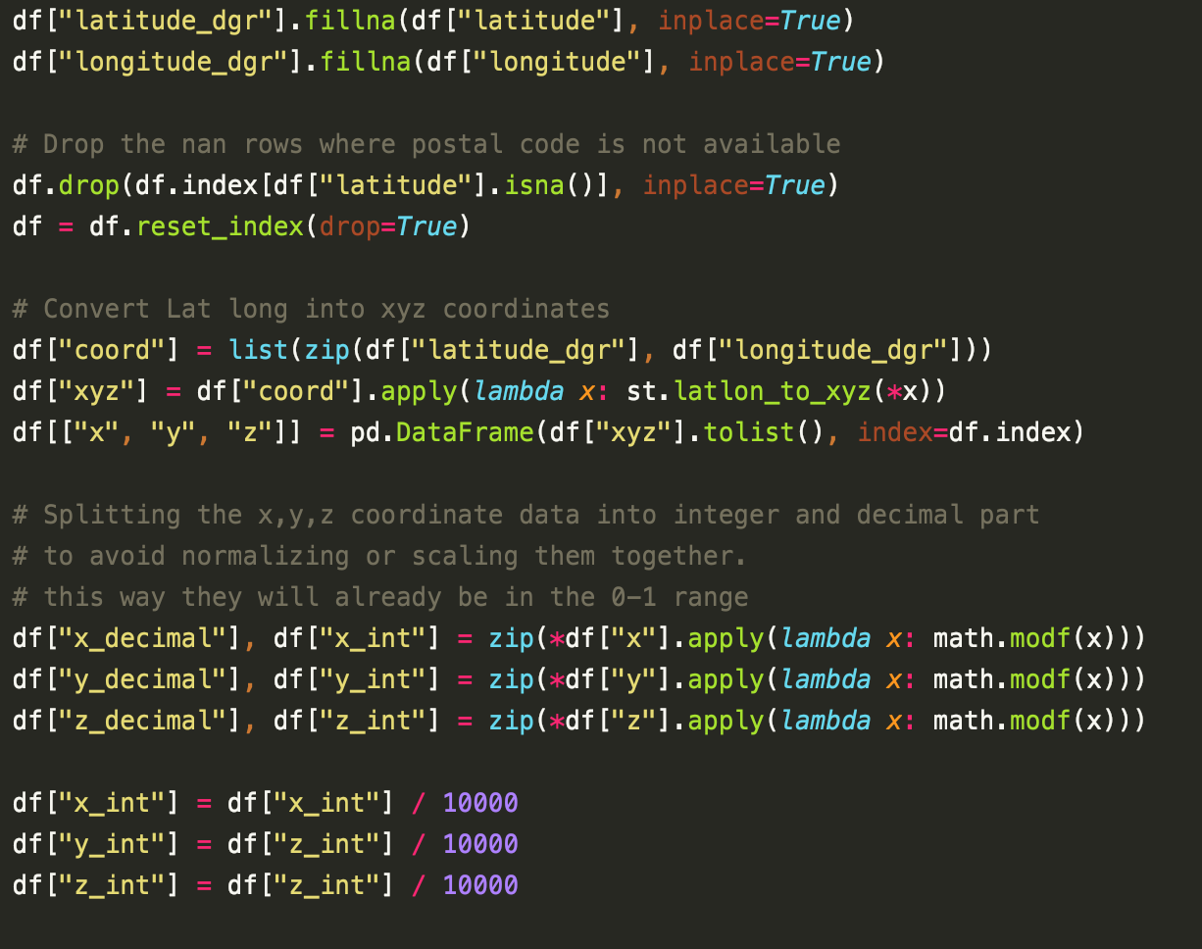
Notes:
What do you do when you are given a set of latitudes and longitudes. You cannot pass them directly or apply some transforms or scaling onto them. That would have a huge shift in what those numbers mean. Slight changes in the digits will point to a completely different location. I found an interesting hack on stack overflow during one of my searches down the rabbit hole and came up with an idea. Convert the coordinated into cartesian x,y,z and then scale the integer and fractional parts

Slide 15
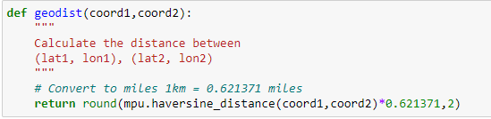
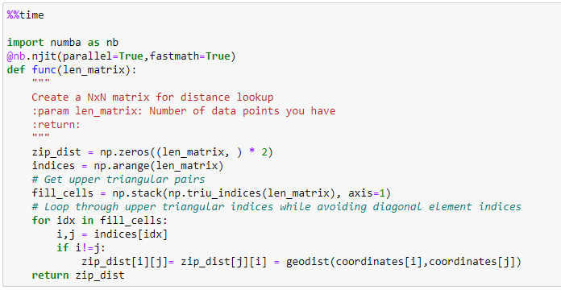
If you have reliable zip-code or co-ordinate details, you can create a matrix lookup table for distances
Notes:
Sometimes having a distance feature might significantly help you cluster and become an important feature for your model to make predictions. It might be expensive to afford zip services or api plugins that give you some calculating methods. My fix is to simply create a lookup table or a matrix of all zipcode combinations. You don’t need extreme precision most of the times. Being in the vicinity or having a coordinate for zipcode is sufficient. The US has 40000 zipcodes, so you can make a one time 40k by 40k matrix and then simply fill values in your data from from that array.

Slide 16
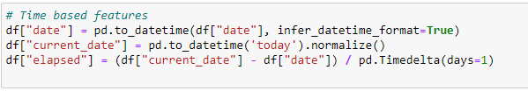
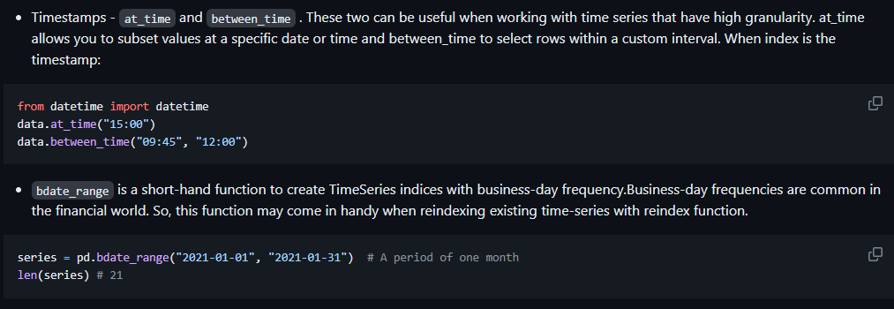
Notes:
Often times people forget that not all timestamps might be from the same timezone. Comparing the durations with timedelta will help with that. Pandas also has a generate function to create a time series between a stop and end point at any granularity. You won’t have to worry about month ends or leap years. It generates the calendar perfectly.

Slide 17
FEATURE ENGINEERING
Space
Latitude and Longitude
Time
Expand on a timestamp
Distance
Calculate between coordinates
Duration
Different timescales and lags
PyCon India 2023
Notes:
We’ve spoken about feature engineering but how can we get to this stage if our data is too big to handle

Slide 18

WHEN SIZE MATTERS
DITCH THE CSV
Start using Parquet files and PyArrow.
NUMPY - .npy
Save and Load using numpy instead
HANDLE WITH VAEX
A python library for lazy Out-of-Core DataFrames , to visualize and explore big tabular datasets with an N-dimensional grid up to a billion objects/rows per second.
PyCon India 2023
Notes:
I found 3 impressively effective ways to get around that and now these are indispensable parts of my code

Slide 19
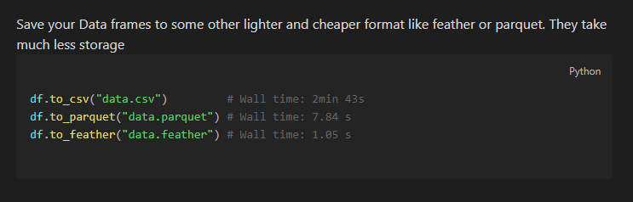
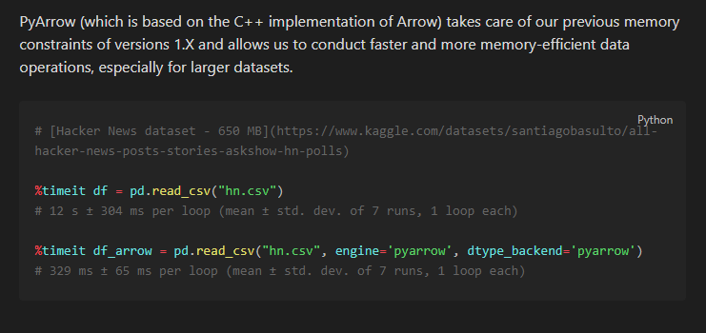
Parquet + PyArrow
.NPY & .NPZ
Notes:
Firstly, forget the csv format. It’s extremely slow and heavy. Pandas especially from 2.0 onwards is built on top of PyArrow. You can see the timing results, almost a 20x speedup. Saving files as parquet is the way to go. Loading a 650mb csv using pyarrow engine gives a 40 X speed up in reading files Sp parquet combined with pyarrow will help you blitz past these issues.

Slide 20
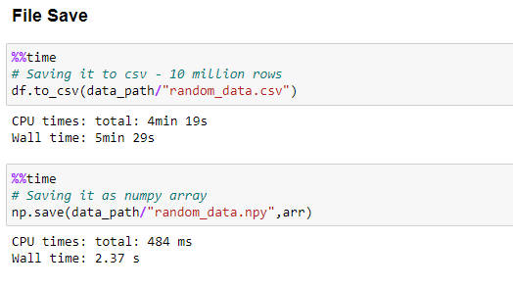
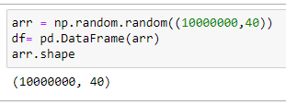
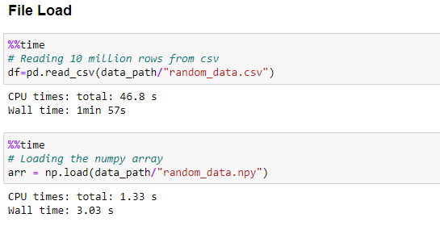
Parquet + PyArrow
.NPY & .NPZ
VAEX
Notes:
If I’m working with a cleaned and processed data set that is perhaps a kind of reference or lookup similar to the zipcode distance lookup I mentioned, I’ll save it as a numpy array any day. It’s not even a question given these speed differentials in loading and saving. Imagine having to wait 5 minutes while your jupyter kernel is frozen or probably restarted. This is an unnecessary obstacle to productivity on a project. Saving an loading as you see on this dummy data are 160X and 40 x respectively.

Slide 21
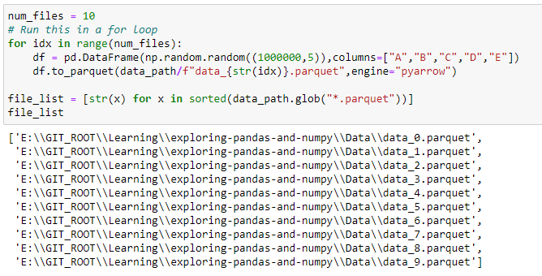
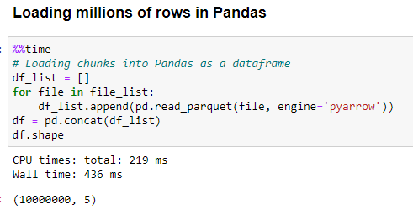
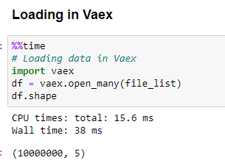
.NPY & .NPZ
VAEX
Notes:
Those were convincing numbers, surely, but the tird tip, Vaex is a python library for lazy Out-of-Core DataFrames (similar to Pandas), to visualize and explore big tabular datasets. It can calculate statistics such as mean, sum, count, standard deviation etc, on an N-dimensional grid up to a billion (109) objects/rows per second. Visualization is done using histograms, density plots and 3d volume rendering, allowing interactive exploration of big data. Vaex uses memory mapping, a zero memory copy policy, and lazy computations for best performance (no memory wasted). A 10 x speedup in loading data

Slide 22

DATA RE-STRUCTURING
SPARSITY AND NON-ZERO ELEMENTS
Using the numpy where condition
INPLACE VS CHAINING
Mutating a data frame through different operations
VECTORIZE WHEN YOU CAN LOOP
Instead of using apply function on multiple columns in a row using lambda
MERGE_ASOF AND MERGE_ORDERED
Variations to merging where order or closeness can matter
EXPLODE AND MELT
Going wide to long format and condensing multiple columns into 1
NUMPY TRICKS
PyCon India 2023
Minor numpy one-liners that come in handy
Notes:
Let’s get our hands dirty with some data manipulation and reconfiguration

Slide 23
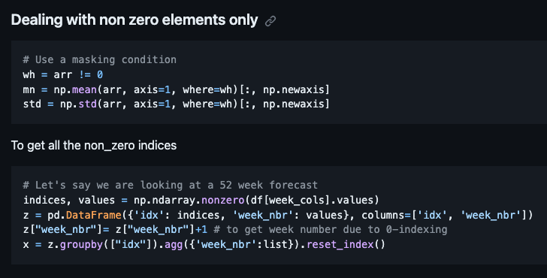
SPARSITY AND NON-ZERO ELEMENTS
Notes:
Often when you are dealing with sparse data or looking for ways to filter some rows out, you may want to do that based on how many useful data points you have per row.. Use the numpy where condition as a binary mask. Most people don’t realize there is a where argument within numpy methods. If you want to identify which index in a row has the non zero elements, Imagine you’re looking at a daily or weekly purchase history. You want to identify what items sell more or when customers buy more, you can create an indices and values column in pandas and then aggregate based on it to find them as a list

Slide 24
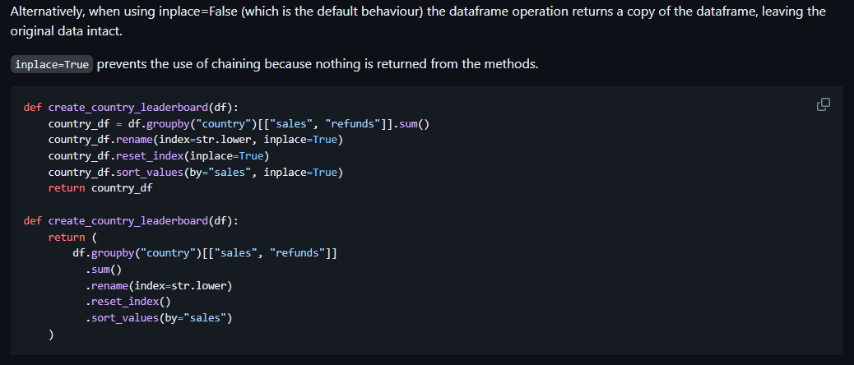
INPLACE VS CHAINING
Notes:
Using the inplace=True keyword in a pandas method changes the default behaviour such that the operation on the dataframe doesn’t return anything, it instead ‘modifies the underlying data’. It mutates the actual object which you apply it to. This means that any other objects referencing this dataframe (such as slices) will now see the modified version of the data — not the original.
Imagine having an ice-cream, it’s frozen, but then you want to melt it. If you use inplace=True you change the state of the object. You can’t get your unmelted ice-cream back.
Alternatively, when using inplace=False (which is the default behaviour) the dataframe operation returns a copy of the dataframe, leaving the original data intact.
inplace=True prevents the use of chaining because nothing is returned from the methods. If you forget to add the inplace=True to one of your lines (I did this when writing one of the examples), you might miss an operation on your dataframe and it can be hard to spot, because you’ll have a random line just not doing anything useful.
If you use Jupyter notebooks, it will make it even harder to manage the state of different objects — if a function that mutates your dataframe ends up erroring half way through the function (also happened to me when writing an example), you will end up with a half mutated dataframe.

Slide 25
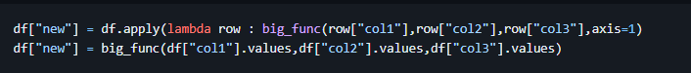
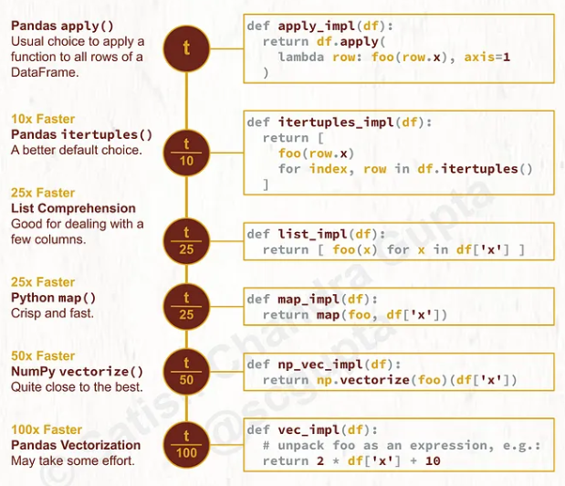
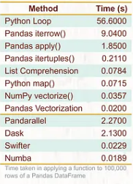
VECTORIZE WHEN YOU CAN LOOP
Source : https://towardsdatascience.com/apply-function-to-pandas-dataframe-rows-76df74165ee4. Image is by the author and released under Creative Commons BY-NC-ND 4.0 International license.
Notes:
Instead of using apply function on multiple columns in a row using lambda, pull them out as df.values and create a new column by sending these arrays of the features as argument to a function. Whenever you find yourself itching to use some looping function like apply, applymap, or itertuples - stop. Use vectorization instead. Pandas has a large collection of vectorized functions

Slide 26
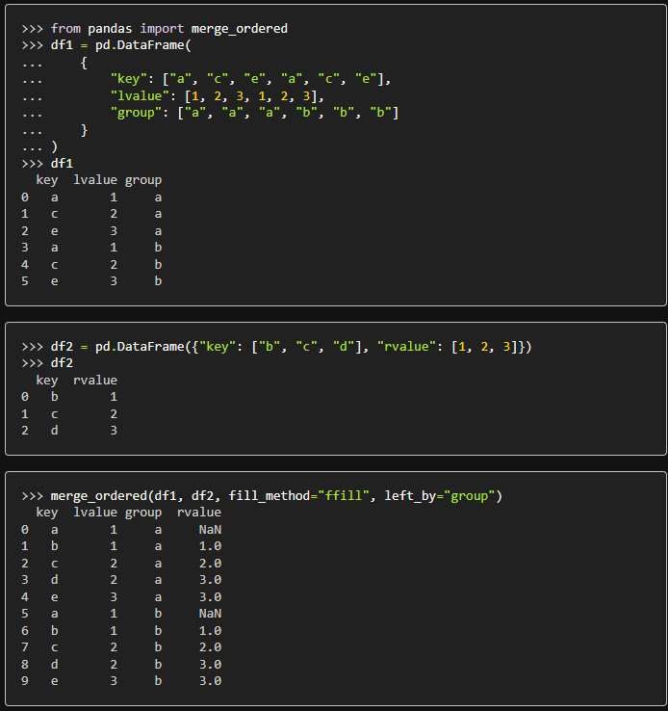
Image is by the author and released under Creative Commons BY-NC-ND 4.0 International license.
MERGE_ORDERED
Perform a merge for ordered data with optional filling/interpolation.
Designed for ordered data like time series data.
Optionally perform group-wise merge
Source : https://pandas.pydata.org/docs/reference/api/pandas.merge_ordered.html
Notes:
This is a variant to merging, where you have a bit more customizability. It’s helpful when you are working with ordered data like a time series and have to merge multiple data sources but get them in order and also fill in any missing values .Since it’s hard to cover with an example, I would suggest going through the pandas documentation for this trick and the next one which is

Slide 27
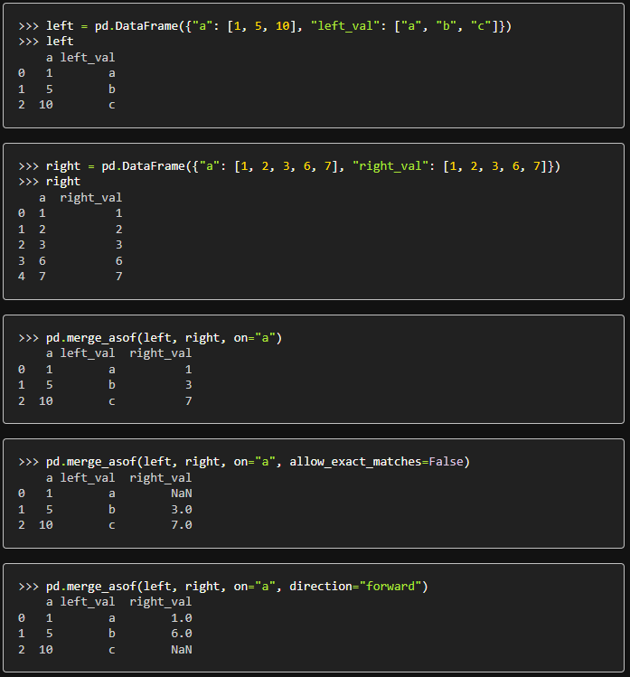
MERGE_ASOF
Perform a merge by key distance.
We match on nearest key rather than equal keys.
Both DataFrames must be sorted by the key.
Direction can be backward, forward or nearest.
Source : https://pandas.pydata.org/docs/reference/api/pandas.merge_asof.html
Notes:
This is like a left-join, except. For each row in the left DataFrame:
A “backward” search selects the last row in the right DataFrame whose ‘on’ key is less than or equal to the left’s key.
A “forward” search selects the first row in the right DataFrame whose ‘on’ key is greater than or equal to the left’s key.
A “nearest” search selects the row in the right DataFrame whose ‘on’ key is closest in absolute distance to the left’s key.
Optionally match on equivalent keys with ‘by’ before searching with ‘on’.

Slide 28
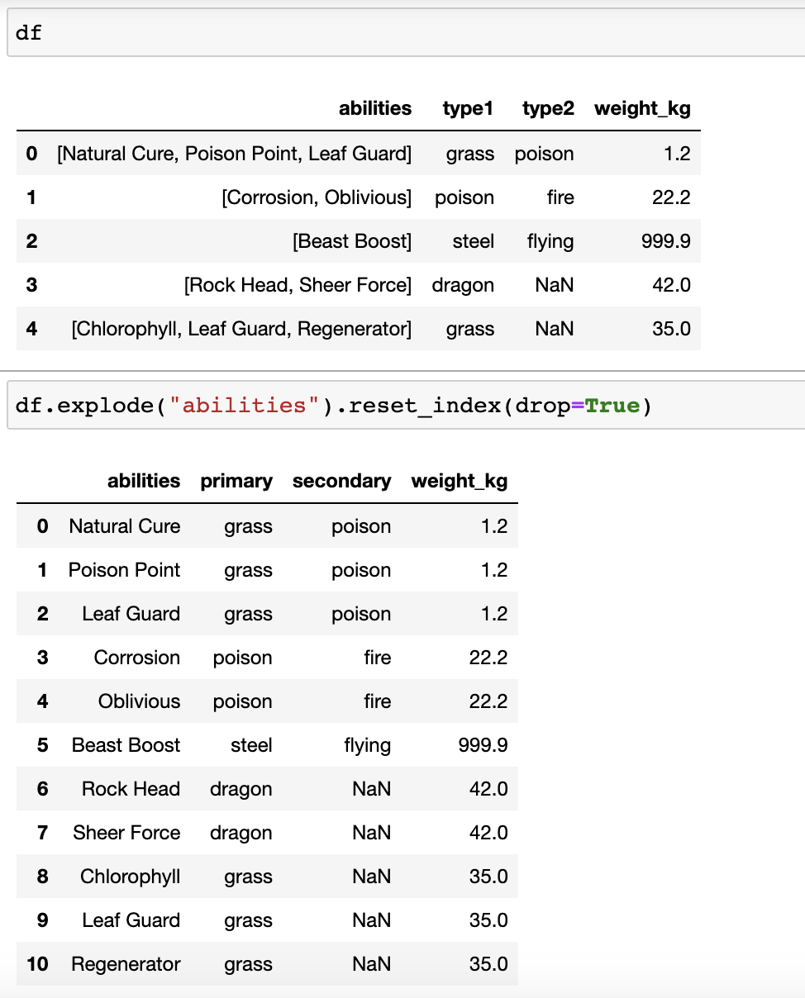
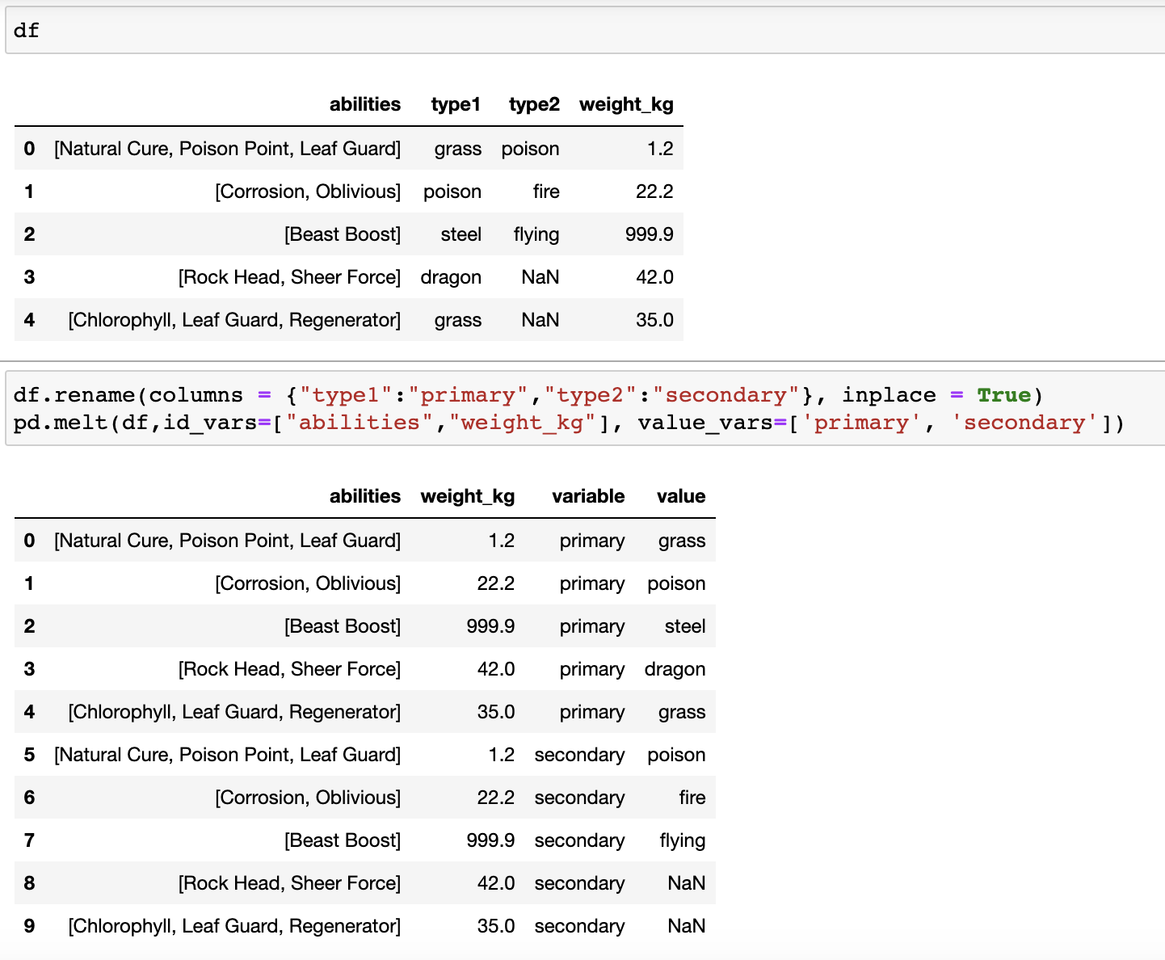
EXPLODE
MELT
Notes:
Explode is a way to expand certain columns that might be lists. Each element becomes one row with the rest of the values replicated. In melt, you can fuse multiple columns to become one column and keep track of the class as a variable column whose value points to the previous feature value.

Slide 29
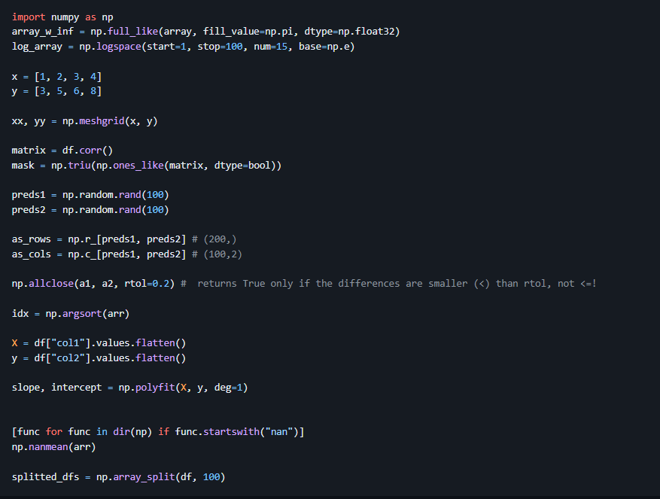
NUMPY TRICKS
Notes:
You may have used np.zeroes_like or np.ones_like. np.full_like takes in a matrix and a fill value and creates the whole matrix.
You might use np.arrange to get an array of numbers but np.linspace can create a custom number of linearly spaced data points within an interval. logspace can generate a custom number of points evenly spaced on a logarithmic scale.
Given 2 arrays you can create every possible coordinate pair from a given X and Y arrays using meshgrid . is usually used for more complex tasks that would take forever if done with loops
np.triu and np.tril are upper and lower and return zeros above or below a certain diagonal of a matrix . create a boolean mask with True values above the main diagonal when plotting a correlation heatmap.
np.vstack and np.hstack are useful when you want to combine arrays into a single matrix for example, ensemble of model predictions. Remember to do .reshape(-1, 1) to each array because stacking needs them to be 2D
np.r_ and np.c_ operators (not functions!) allow stacking arrays as rows and columns, respectively.
Takes arrays and crush them into 1D using np.ravel or np.flatten . flatten always returns a 1D copy while ravel tries to produce a 1D view of the original array.
Use np.allclose which returns True if all elements of an array are close to each other, given some tolerance.
np.polyfit can take two vectors, apply linear regression on them and return a slope and an intercept. You just have to specify the degree with deg, because this function can be used to approximate the roots of any degree polynomial.
np.array_split used to chunk ndarrays or DataFrames into N buckets. Besides, it doesn't raise an error when you want to split the array into non-equal sized chunks like np..vsplit

Slide 30

UTILIZE THE TIPS
In this talk we have gone over 25+ tricks that are not so common
Start looking at documentation of Pandas and Numpy to discover new updates
Collect and maintain a Jupyter Notebook or Markdown file of code snippets
Optimize the effort and time taken to clean or process data
Code snippets mentioned in this talk can be found here, so that you don’t begin from scratch
https://github.com/snknitin/exploring-pandas-and-numpy
Now get to work !!
PyCon India 2023

Slide 31

Q&A
PyCon India 2023

Slide 32
THANK
YOU
Website - https://snknitin.github.io
Blogs - https://medium.com/@snk.nitin
Github - https://github.com/snknitin
LinkedIn - https://www.linkedin.com/in/nitinkishore/
Twitter - https://twitter.com/Nitin_wysiwyg
My presentation, comments and opinions are provided in my personal capacity and not as a representative of Walmart. They do not reflect the views of Walmart and are not endorsed by Walmart.
Notes:
Feel free to reach out to me on any platform if you have additional questions or want to have any discussion offline

Slide 33
THANK
YOU

